Slide 1
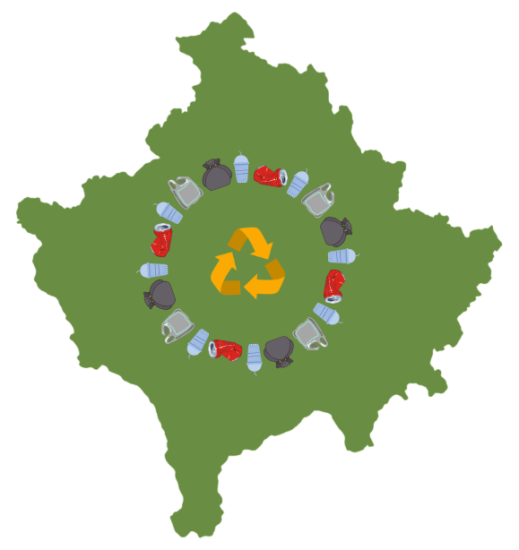




From Policy to Practice
Law on Integrated Waste Management & Extended Producer Responsibility
Agim Mazreku Advisor on Climate, Environment and Energy
Ministry of Environment, Spatial Planning and Infrastructure
Republika e Kosovës
Republika Kosova - Republic of Kosovo
Qeveria - Vlada - Government
Ministria e Mjedisit, Planifikimit Hapësinor dhe Infrastrukturës
Ministarstvo Zivotne Sredine, Prostornog planiranja i Infrastrukture
Ministry of Environment, Spatial Planning and Infrastructure

Slide 2

Pathways to a Circular Future: A New Law
Kosovo is transitioning from waste disposal to resource management.
The Ministry of Environment, Spatial Planning and Infrastructure has initiated the drafting of a new Law on Integrated Waste Management, which is foreseen in the Government Legislative Program for 2025.
This Law will address current challenges in the sector and further align Kosovo with the EU Waste Framework Directive and the Circular Economy Action Plan (2020).
The goal of the Government is to build a modern, transparent, and sustainable integrated waste system that supports a circular economy.

Slide 3
Why a New Law?
Current Challenges
Current Challenges
Outdated legal base (Law No. 04/L-060, 2012, with focused amendments in 2022 and 2024 related to permits and harmonization with administrative procedures)
Weak provisions for Extended Producer Responsibility and Deposit Return System
Fragmented institutional roles
Lack of financial sustainability and data transparency
Heavy dependence on landfilling (≈90% of municipal waste)

Slide 4
Why a New Law?
Current Challenges
Current Challenges
Policy & Legal Context
Outdated legal base (Law No. 04/L-060, 2012, with focused amendments in 2022 and 2024 related to permits and harmonization with administrative procedures)
Weak provisions for Extended Producer Responsibility and Deposit Return System
Fragmented institutional roles
Lack of financial sustainability and data transparency
Heavy dependence on landfilling (≈90% of municipal waste)
The Integrated Waste Management Strategy 2024–2035, approved by the Government in December 2024, together with the Concept Document on Integrated Waste Management Reform, endorsed in October 2024, provides a clear policy direction and framework for advancing waste sector reforms in Kosovo.

Slide 5
Core Principles and Institutions of the New Law
Waste hierarchy: Prevention → Reuse → Recycling → Recovery → Disposal
Polluter Pays Principle (PPP) – producers, companies and households take financial responsibility for managing the waste they create
Full Net Cost Coverage (FNCC) – collection, transport, recycling and treatment to be covered by the fees paid by users or producers
Transparency and accountability – all institutions and parties report clearly on what they collect, recycle or dispose
Recycling targets of the Strategy must be achieved

Slide 6
Core Principles and Institutions of the New Law
Extended Producer Responsibility Schemes & Deposit Refund System are enshrined in the law
Inter-municipal Cooperation and definition of five Waste Management Zones are integrated in the law, alongside checks and balances enabling sanctions or government intervention when services fail
A Regulator will oversee tariff setting, performance monitoring and dispute resolution
The role of KLMC will be strengthened in the law to operate landfills and treatment facilities, including future regional sorting and treatment centers

Slide 7
Extended Producer Responsibility Scheme & Deposit Refund System
The new law introduces a strong legal basis for Extended Producer Responsibility (EPR) schemes, covering Packaging; WEEE (electronic waste); Batteries; End-of-life vehicles (ELV); Tyres and other waste streams
It also establishes a strong legal basis for Deposit Refund System (DRS) for plastic, glass and aluminum bottles (ranging from 0.15 to 2 liters) to increase collection and recycling rates and reduce littering nationwide.
Sets:
Clear roles for producers, Producer Responsibility Organizations, municipalities, and recyclers
Transparent data reporting and performance monitoring
2023
2026
2027

Slide 8
Extended Producer Responsibility Scheme & Deposit Refund System
2023
2026
2027
EPR Assessments for WEE, Batteries, ELVs, Oils

Slide 9
Extended Producer Responsibility Scheme & Deposit Refund System
2026
2023
2027
EPR Assessments for WEE, Batteries, ELVs, Oils
Legal base for EPR introduced into the New Law on Integrated Waste Management
EPR assessments for Tires and Packaging

Slide 10
Extended Producer Responsibility Scheme & Deposit Refund System
2027
2023
2026
EPR Assessments for WEE, Batteries, ELVs, Oils
Legal base for EPR introduced into the New Law on Integrated Waste Management
EPR assessments for Tires and Packaging
New Secondary Legislation including EPR adopted

Slide 11

Data, Monitoring & Enforcement
Establishment of a National Waste Information System (NWIS).
Mandatory reporting by municipalities, operators, and PROs.
Strengthened inspection powers.
Regular performance and compliance audits.

Slide 12
Institutional Framework
MESPI
Leads national waste policy and strategies
Prepares primary and secondary legislation on integrated waste management system and oversees implementation
Permits – PROs licensing

Slide 13
Institutional Framework
KEPA
Collects and manages national waste data
Monitors compliance and reporting

Slide 14
Institutional Framework
Inspectorate
Ensures that all operators follow the law
Enforces penalties for illegal dumping or non-compliance

Slide 15
Institutional Framework
KLMC
Operates landfills and treatment facilities including future regional sorting and treatment centers
Ensures safe and environmentally sound disposal

Slide 16
Institutional Framework
Municipalities
Organize local waste collection and separate recycling streams (through regional or individual companies).
Raise public awareness and improve local services (through regional or individual companies)
Cooperate with other municipalities in shared waste zones
Municipalities through regional or individual companies manage sorting at the source.

Slide 17
Institutional Framework
Producers and companies will take responsibility for the waste their products create, through EPR Schemes (e.g: packaging, electronics, batteries)
Recycling companies and PROs will manage collection, sorting and recycling
Investors and innovators can develop new recycling plants, repair and reuse businesses, and digital waste tracking services
PPPs are preferred to engage experienced EU to build modern waste and recycling infrastructure
Private Sector

Slide 18
Institutional Framework
Hybrid Regulator
For tariff setting, performance monitoring and dispute resolution

Slide 19
Institutional Framework
Cross-Sector Coordination
Coordinates policies and investments
Includes central and local institutions, private sector, civil society and donors

Slide 20















Recyclable Waste
3 bin system – Apartment Blocks
Recycling Market
Plastic
Paper
Glass
24.8 % Recycling
Recycling Total: 50%
2 bin system – Individual Houses
Mix
Glass
RDF/ WtE
Sorting Centre
MBT (tunnel)
6.2 % Recycling
Civic Amenity Centers
(recycling yards)
Transfer Station
Residual (mixed) Waste
Composting Plant
Green Waste in Urban Areas
Public Spaces (parks)
3.3 % Recycling
Landfill
Food Waste in Urban Areas
Anaerobic Digestion
6.3 % Recycling
20% Landfilled
Home Composting
Green and Food Waste Individual Housing
9.5 % Recycling

Slide 21
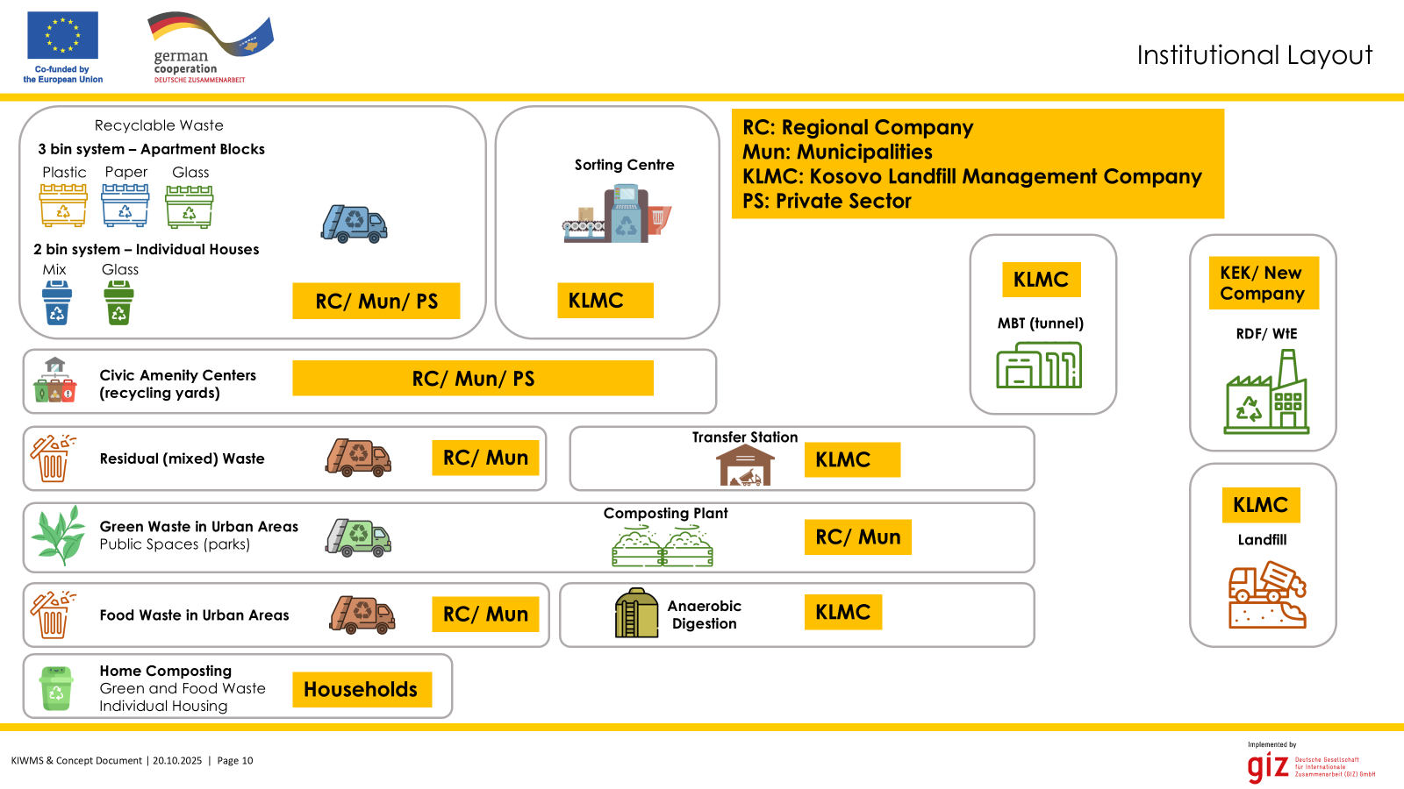

Slide 22
Way Forward
The new Law on Integrated Waste Management establishes the foundation for a comprehensive transformation of the sector, translating policy objectives into a strong legal framework that drives Kosovo toward circular economy.
It will ensure:
Environmental protection
Promote economic opportunities and
Strengthen social inclusion and shared responsibility.
Nov-Dec
2025
Feb-Mar 2026
Aug-Sep 2026
Feb-Mar 2027

Slide 23
Depending on the external factors the work plan may change, but the Government's goal is to take into account the proposals of the public, stakeholders and those affected by this policy throughout the process of drafting the Draft Law. Therefore, we encourage you to be as involved as possible in all phases of the consultations to ensure a Law that is applicable in practice.
Nov-Dec
2025
Feb-Mar 2026
Aug-Sep 2026
Feb-Mar 2027
Development and finalization of the draft law

Slide 24
Depending on the external factors the work plan may change, but the Government's goal is to take into account the proposals of the public, stakeholders and those affected by this policy throughout the process of drafting the Draft Law. Therefore, we encourage you to be as involved as possible in all phases of the consultations to ensure a Law that is applicable in practice.
Feb-Mar 2026
Nov-Dec
2025
Aug-Sep 2026
Feb-Mar 2027
Development and finalization of the draft law
Approval by the Government

Slide 25
Depending on the external factors the work plan may change, but the Government's goal is to take into account the proposals of the public, stakeholders and those affected by this policy throughout the process of drafting the Draft Law. Therefore, we encourage you to be as involved as possible in all phases of the consultations to ensure a Law that is applicable in practice.
Aug-Sep 2026
Nov-Dec
2025
Feb-Mar 2026
Feb-Mar 2027
Development and finalization of the draft law
Approval by the Government
Approval by the Assembly

Slide 26
Depending on the external factors the work plan may change, but the Government's goal is to take into account the proposals of the public, stakeholders and those affected by this policy throughout the process of drafting the Draft Law. Therefore, we encourage you to be as involved as possible in all phases of the consultations to ensure a Law that is applicable in practice.
Feb-Mar 2027
Nov-Dec
2025
Feb-Mar 2026
Aug-Sep 2026
Development and finalization of the draft law
Approval by the Government
Approval by the Assembly
Issuance of secondary legislation
Including EPR secondary legislation

Slide 27
Contact Us
Agim Mazreku Advisor on Climate, Environment and Energy
Ministry of Environment, Spatial Planning and Infrastructure
agim.mazreku@rks-gov.net
Republika e Kosovës
Republika Kosova - Republic of Kosovo
Qeveria - Vlada - Government
Ministria e Mjedisit, Planifikimit Hapësinor dhe Infrastrukturës
Ministarstvo Zivotne Sredine, Prostornog planiranja i Infrastrukture
Ministry of Environment, Spatial Planning and Infrastructure

